Slide 1
Introduction to Computer Programming Lecture 2.3:
Control Flow
Hemma Philamore
Department of Engineering Mathematics

Slide 2
Introduction to Computer Programming Lecture 2.3.a:
Introduction to Control Flow
Department of Engineering Mathematics
Hemma Philamore

Slide 3


Controlling the flow
Conditional statements run different blocks of code depending on whether a Boolean condition evaluates to true or false.
x
Conditional:
controlling the workflow
x > 10
True
False
Do this!
Do that!

Slide 4
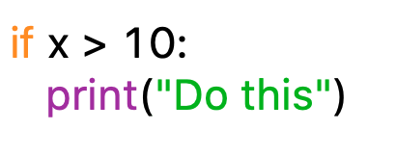
Conditional Statements
If... then...: Runs the block of code only if the condition is true.
x
conditional
colon
x > 10
True
False
Do this!
indentation
Further code

Slide 5
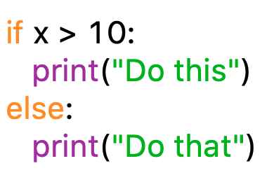
Conditional Statements
If... then... else...: Runs the block of code under “then” only if the condition is true. Runs the “else” code otherwise.
conditional
colon
colon
x > 10
indentation
indentation
if
True
False
else
Do this!
Do that!
Further code

Slide 6
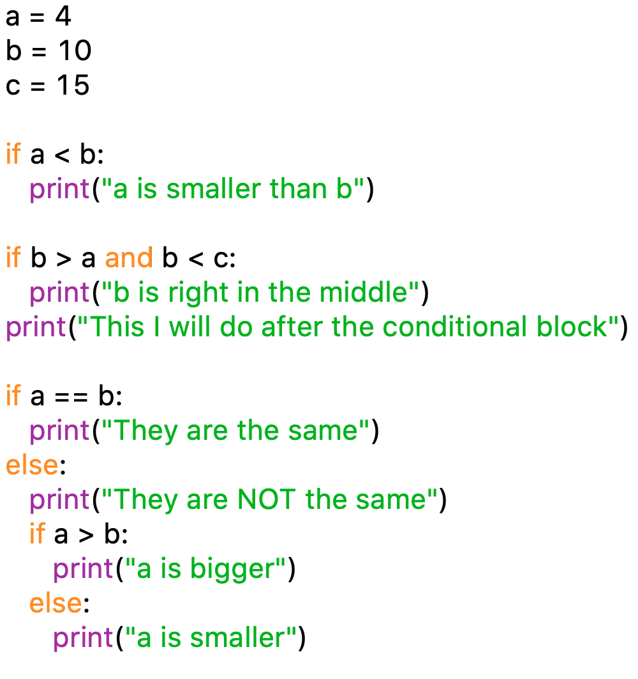
Conditional Statements
indentation defines blocks
inside the block
outside the block
nested conditions

Slide 7
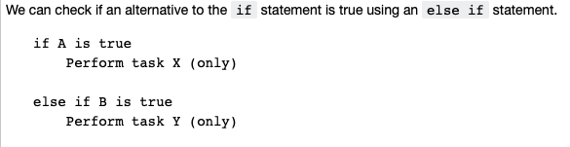
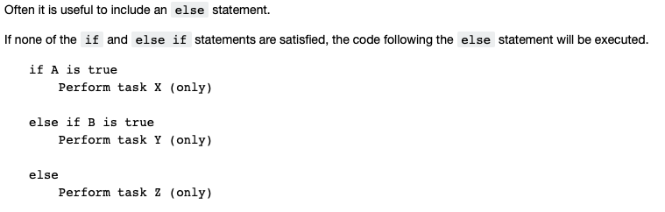

Slide 8
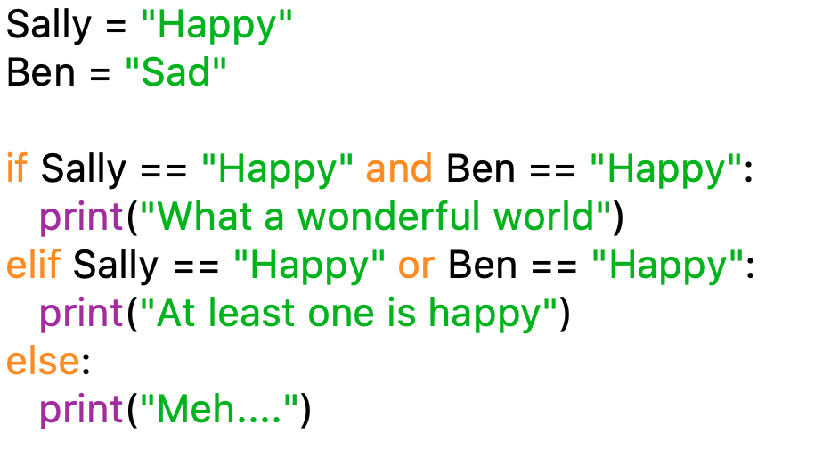
Chain of Conditional Statements
Conditional statements allow you to execute a block of code based on a condition.
Use boolean operators to compare two values: ==, !=, <=, >=, >, <.
Boolean logic is especially useful here: and, or.

Slide 9
Introduction to Computer Programming Lecture 2.3.b:
Control Flow Example : Time Telling
Department of Engineering Mathematics
Hemma Philamore

Slide 10
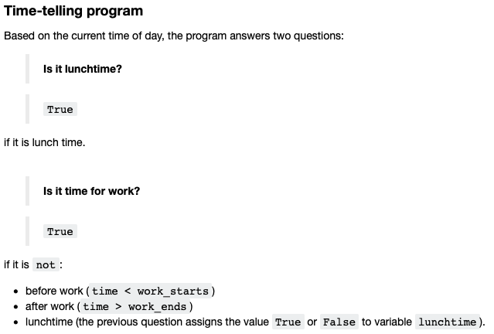

Slide 11
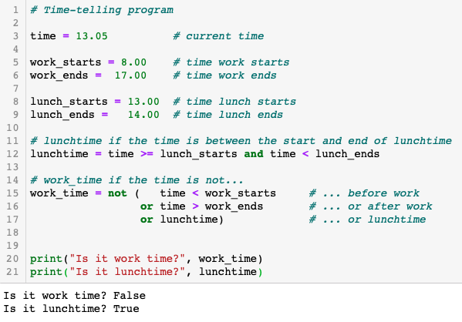

Slide 12

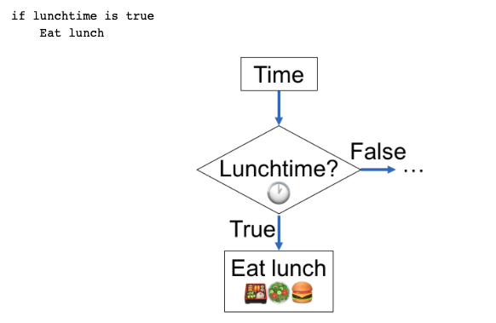

Slide 13
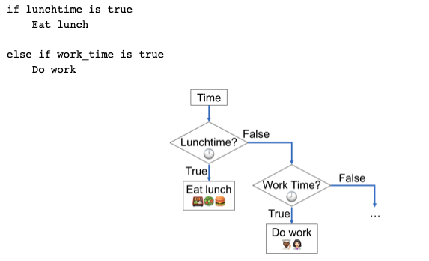

Slide 14
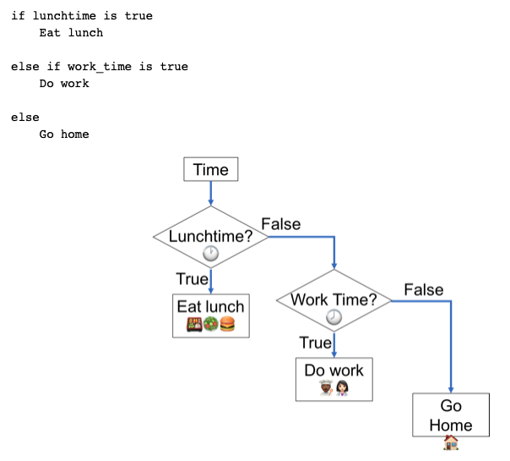

Slide 15
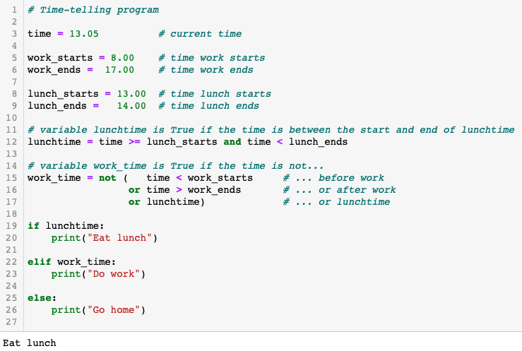

Slide 16
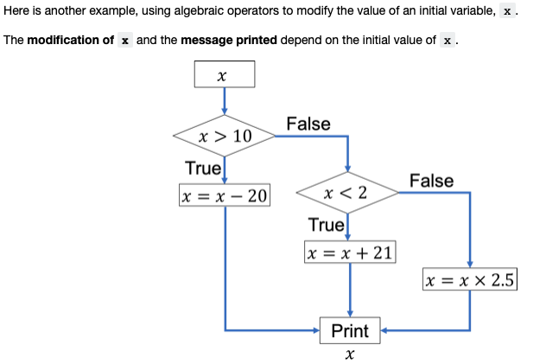

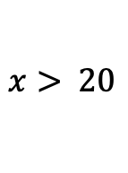
$$x> 20$$
$$5<x<10$$

Slide 17
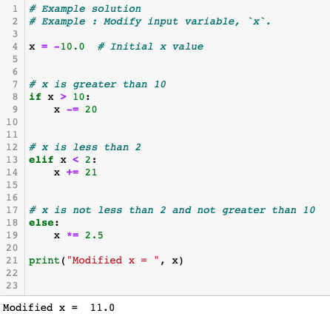

Slide 18
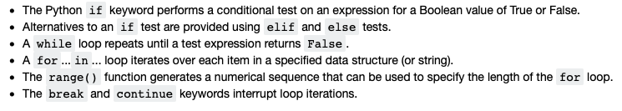
Summary
Control Flow

